Slide 1

Chapter 9
Lifespan Development

Slide 2

Self-concept
Self-recognition: evidence from the mirror test.
2-4 years old: socialize with others, cooperate with others, carry out plans.
School-age: identify with groups, compare with peers
Children with a positive self-concept:
More confident, do better in school, act more independently, etc.

Slide 3

Parenting and self-concept
Authoritative: gives reasonable demands and limits, express warmth and affection, and listens to the child’s point of view.
Authoritarian: emphasizes conformity and obedience from the child, strict, and tightly monitor the kids.
Permissive: very nurturing, loving, play the role of friend rather than parent, make few demands, rarely use punishment.
Uninvolved: indifferent, neglectful.

Slide 4
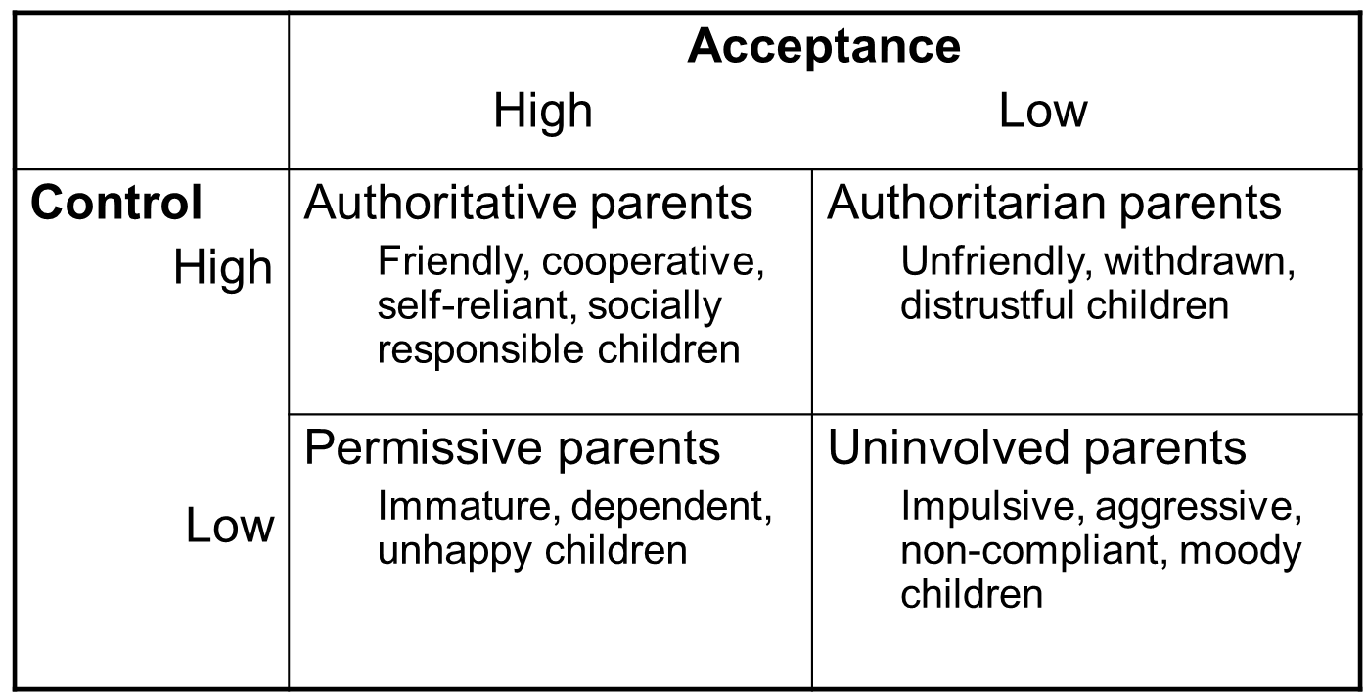
Parenting and self-concept

Slide 5
Parenting Styles and Culture
There is no universally “best” style of parenting
Culture plays a big role in parenting styles
e.g., parenting styles tend to be more authoritarian in collectivist cultures
Children are expected to respect and obey their elders
Different disciplinary styles have different meanings in different cultures and subcultures

Slide 6



Tiger Mother controversy:
Your opinion?
• attend a sleepover
• have a playdate
• be in a school play
• complain about not being in a school play
• watch TV or play computer games
• choose their own extracurricular activities
• get any grade less than an A
• not be the No. 1 student in every subject except gym and drama
• play any instrument other than the piano or violin
• not play the piano or violin.

Slide 7

Adolescence

Slide 8
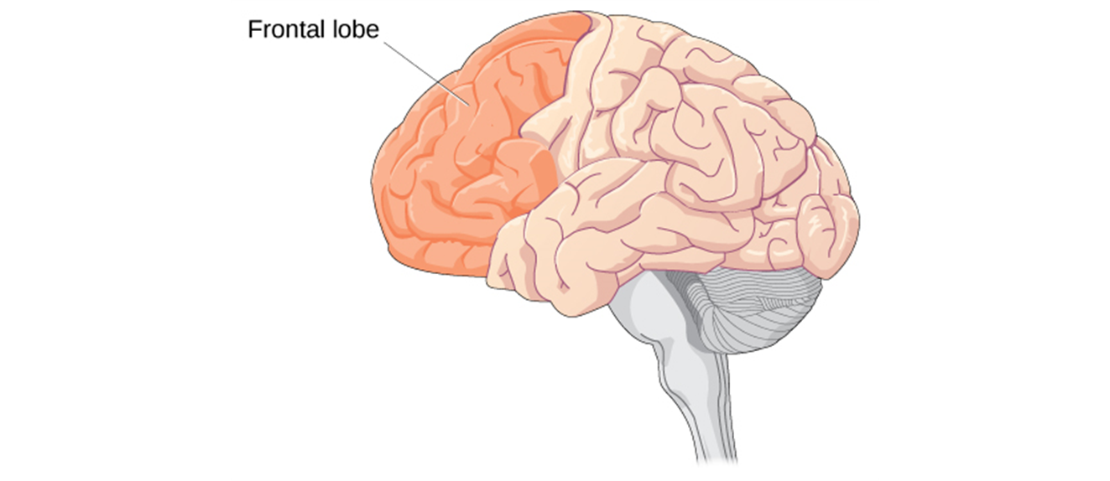
Physical development
Rates of physical development vary widely among teenagers:
Early maturing boys: Greater risk for substance abuse and early sexual activity.
Early maturing girls: Greater risk for depression, substance abuse, and eating disorder.
Late blooming boys: higher risk for depression and conflict with parents, more likely to be bullied.
Frontal lobes of teenagers are still developing. Thus, teenagers are vulnerable to risk-taking behaviors and emotional outbursts.

Slide 9
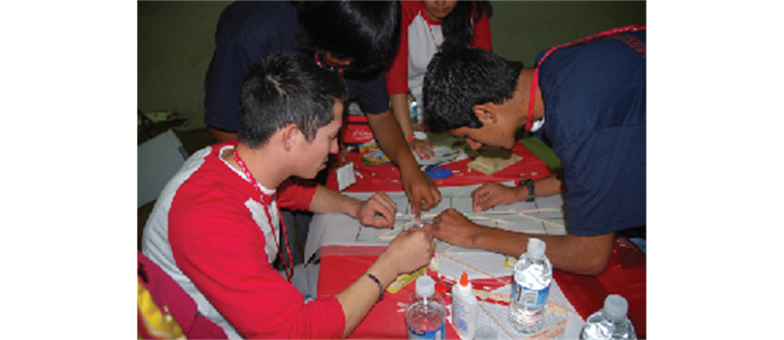
Cognitive development
Enter Piaget’s formal operational stage
Enables abstract, hypothetical thinking
Provides enhanced executive functions
Better reasoning, planning for the future, and foreseeing consequences
More strategic, self-organized thinking
Better multitasking
Better impulse control

Slide 10
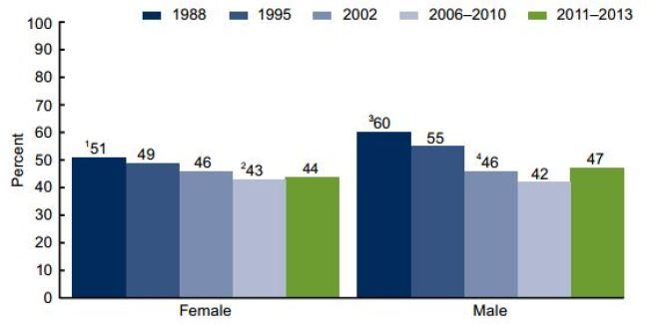
Psychosocial development
Erikson: identity vs. role confusion (“Who am I?” “What do I want to be?”)
Nearly half of 15-year-olds and 70 percent of 18-year-olds in the United States have romantic relationships
60 percent of these relationships last a year or more
Romantic relationships linked with feelings of self-worth, competence, and belonging to a peer group
Nearly 50% of U.S. teens over 16 have had sex

Slide 11
Emerging Adulthood
18-25: explore life’s possibilities before settling into stable adult roles and responsibilities.
Cultural differences:
African country of Malawi: People take on adult responsibilities as early as 10 years old.
Developed countries: The onset of adult life is delayed.

Slide 12

Adulthood

Slide 13

Physical development
Early adulthood (20-early 40s): physical abilities at their peak
Middle adulthood (mid 40s-60s): gradual physical decline
Late adulthood (60s onwards): significant physical decline

Slide 14
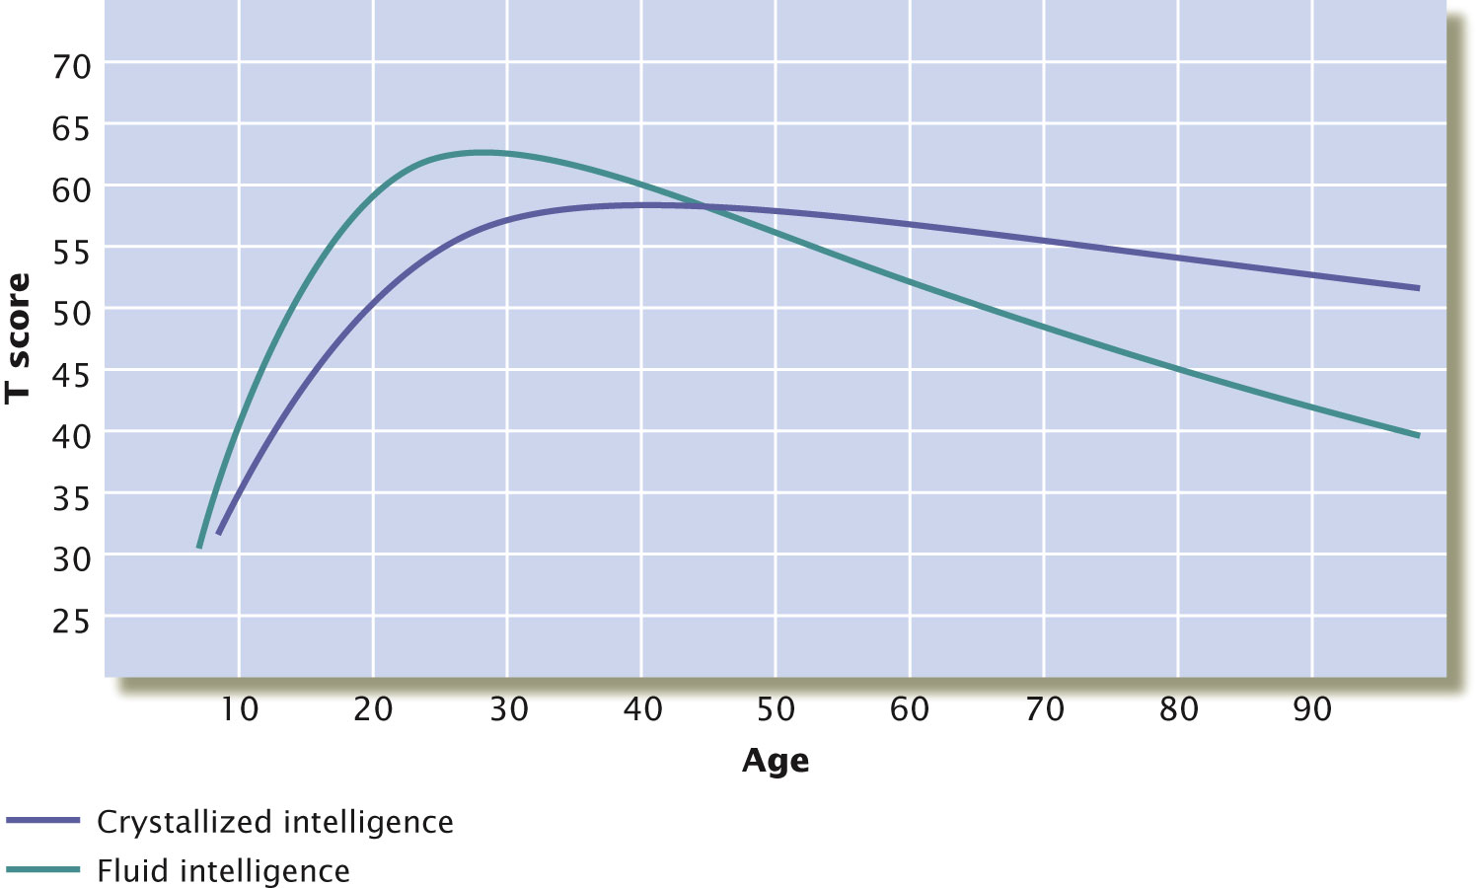
Cognitive Changes
Early & middle adulthood: Cognitive abilities improve
More complex and adaptive
More dialectical
Late adulthood:
Noticeable declines in fluid intelligence (information processing, reasoning)

Slide 15

Psychosocial development
Find meaning throughout our lives – careers.
Positive relationships with family (spouses, children, and parents).
Social connectedness.

Slide 16

Death and Dying
Denial
Bargaining
Depression
Anger
Acceptance
How would people accept their own death?
Creating meaning through death: Randy Pausch “The Last Lecture”

